Slide 1
Office 365 Development
October 2014

Slide 2

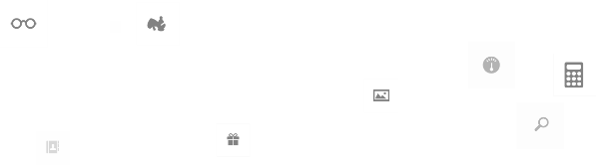
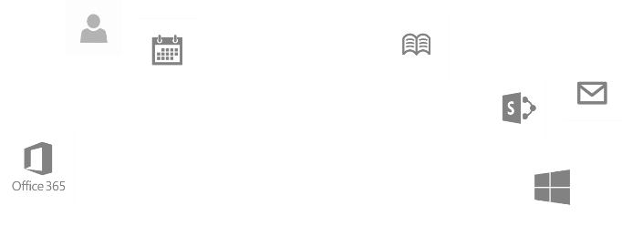
Recap
Introduction to Office 365 development
Module 1: Introduction to Office 365 development
Module 2: Getting started with Apps for Office
Module 3: Getting started with Apps for SharePoint
Module 4: Moving Full Trust Code to the Cloud Using Repeatable Patterns and Best Practices
Module 5: Getting started with the Office 365 APIs
dev.office.com/training

Slide 3
This Course Agenda
Deep Dive into Integrating Office 365 APIs with Web Applications
Module 1: Deep Dive into Azure AD with the Office 365 APIs
Module 2: Deep Dive into Office 365 APIs for Calendar, Mail, and Contacts
Module 3: Deep Dive into Office 365 APIs for OneDrive for Business
Module 4: Deep Dive into Office 365 APIs for SharePoint Site services
Module 5: Deep Dive into Office 365 APIs for Yammer services
Module 6: Deep Dive into Office 365 APIs for Office Graph
Module 7: Deep Dive into Office 365 APIs for OneNote services

Slide 4
Deep Dive into Office 365 APIs for Yammer services
Speaker
Speaker

Slide 5

Agenda
Overview
REST API
OpenGraph Protocol
Embedding

Slide 6
Overview

Slide 7
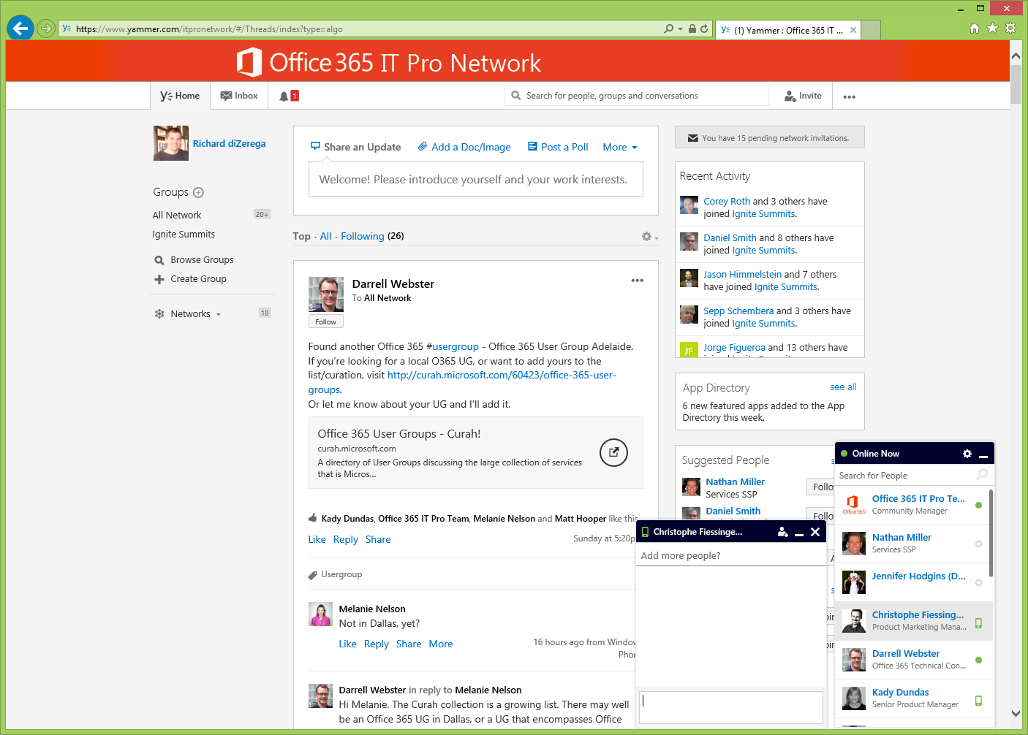
Yammer 101
Groups
Activity Stream
Networks
News feed
Private messaging
Notes:
It’s good to break down the components of Yammer and see them on the UI prior to going into the examples of extending the platform into other components.

Slide 8
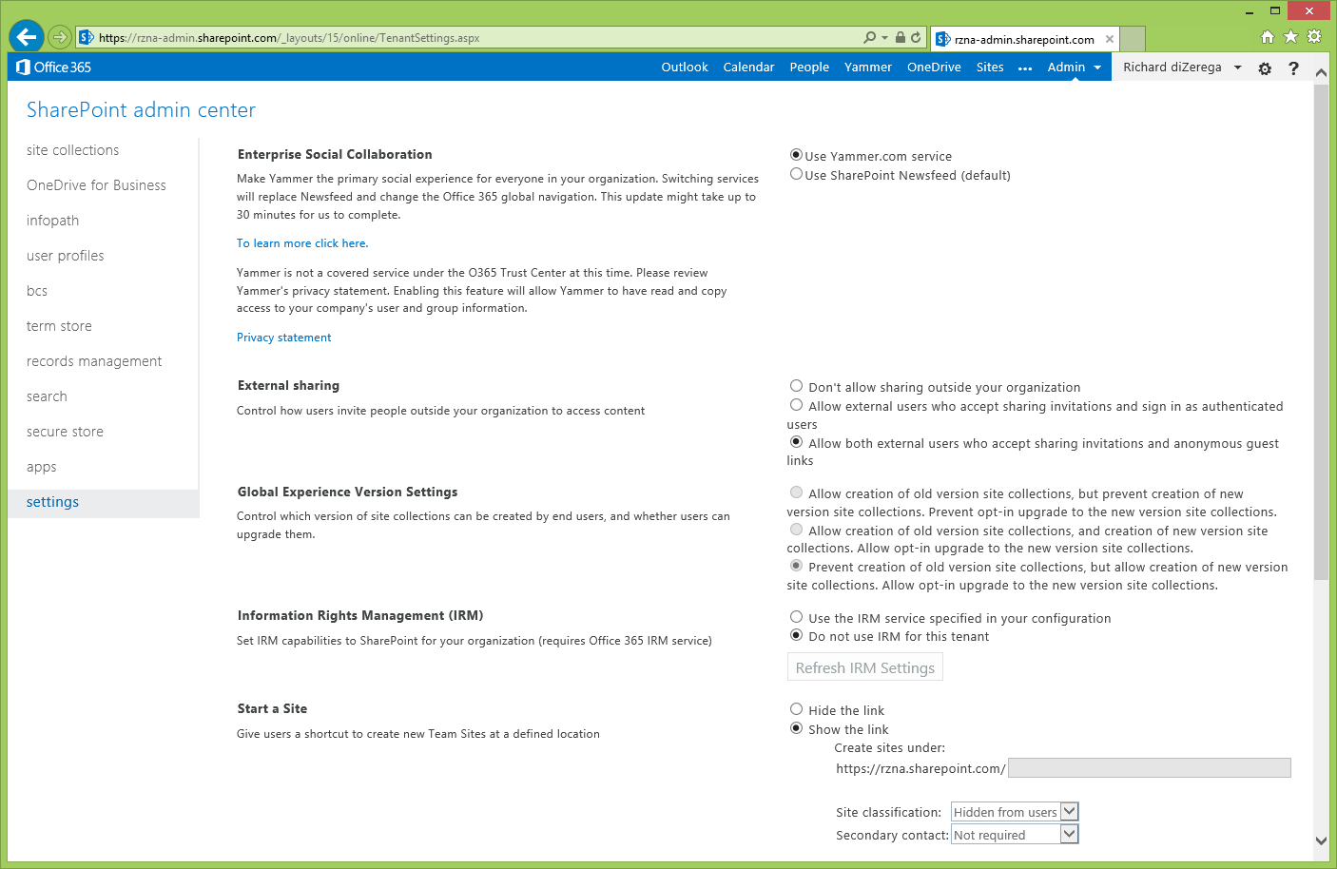
Making Yammer Default for Social

Slide 9
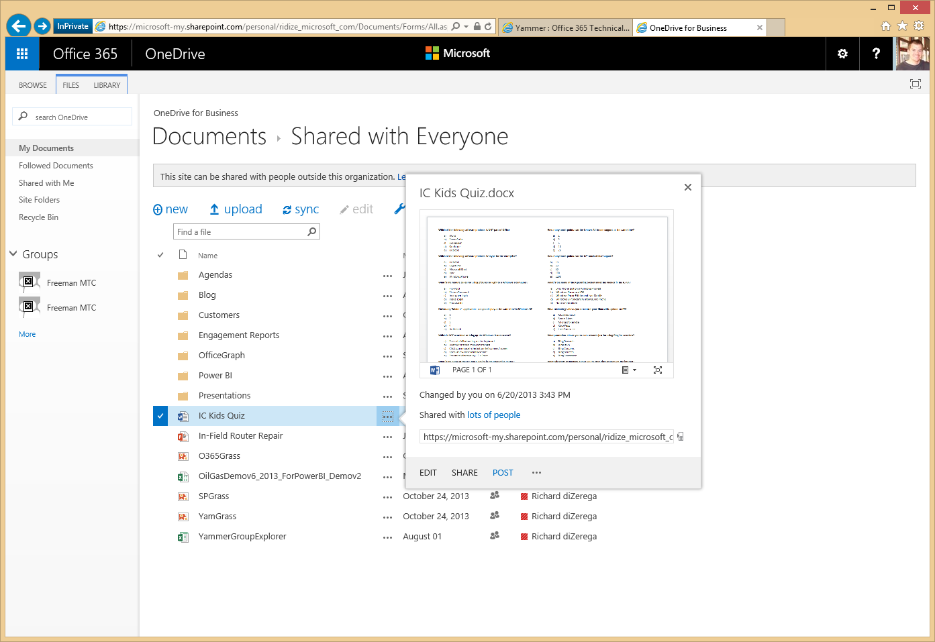
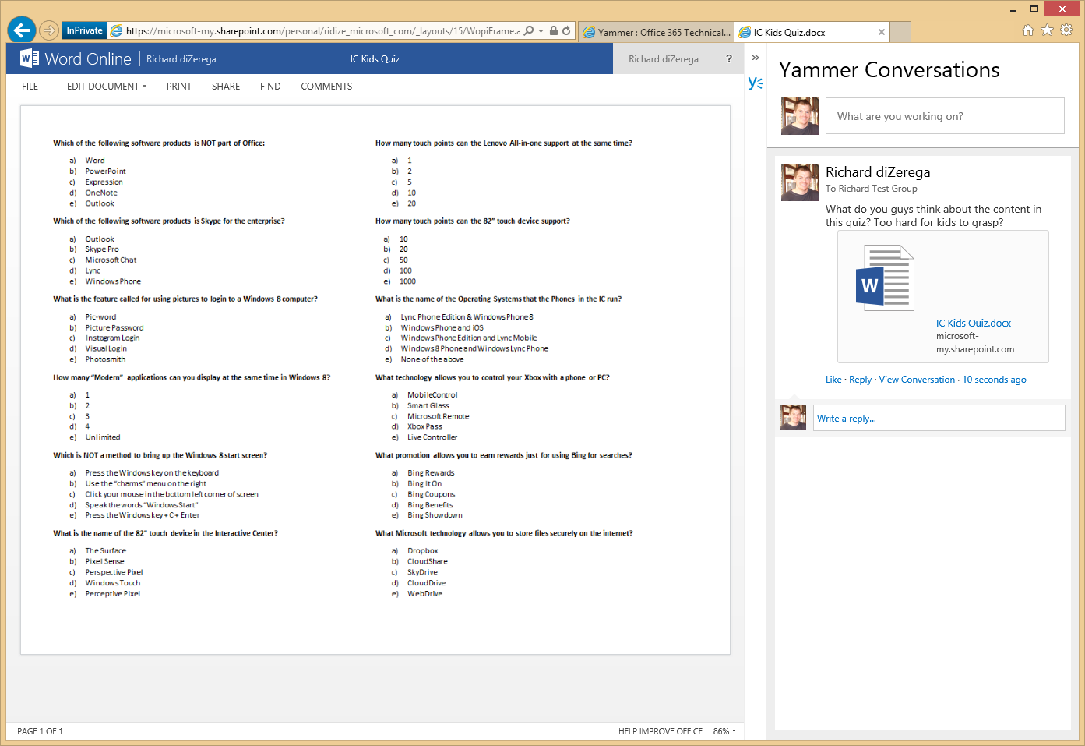
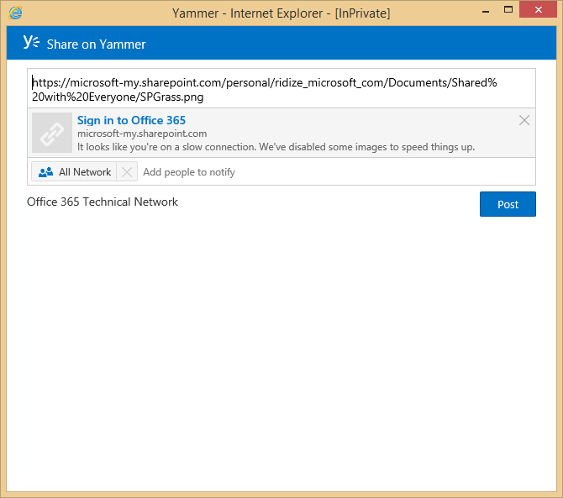
What does that give me?
Notes:
Selecting Yammer as default Enterprise Social Tool will replace “Newsfeed” with link to Yammer and will add POST to Yammer on all documents

Slide 10


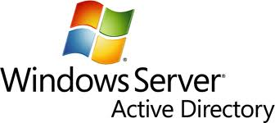
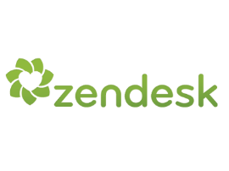
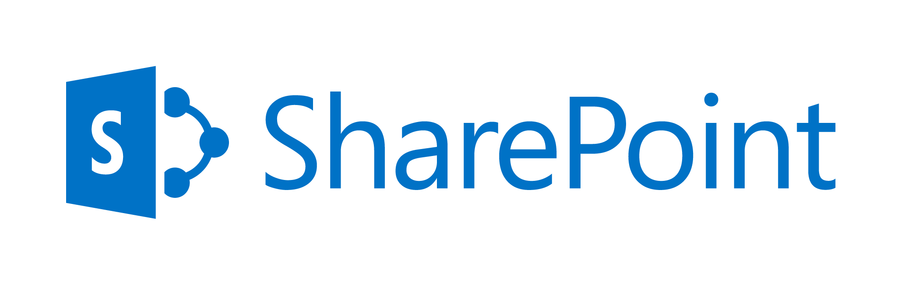


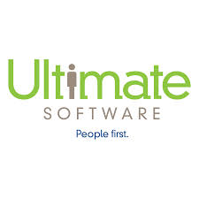

Integration Vision
Stories
CMS
CRM
Legacy Applications
Human Resources
ERP
Sentiment Analysis
Customer Support
Notes:
It is important that the Social layer spans more than SharePoint. With Yammer, Social can be integrated into other CMS, CRM, Legacy applications, etc. Moving to Yammer helps with building actionable items legacy platforms as well. We will cover this in more detail when we look at embedding and the OpenGraph.

Slide 11
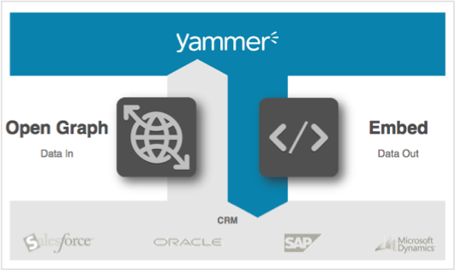
Data In/Data Out
Data In
Send activities from external applications to Yammer using Open Graph.
Data Out
Place Yammer in external applications with Yammer Embed or Development with Yammer APIs/SDKs.
Notes:
There are two basic ways to integrate Yammer. We can have Data In for actionable items, such as Post Document to feed or send Sales Activity to Yammer Group. The other basic approach is to have Yammer data published outside of Yammer, such as the Yammer SharePoint App (newsfeeds,
Comment feeds, etc.)

Slide 12
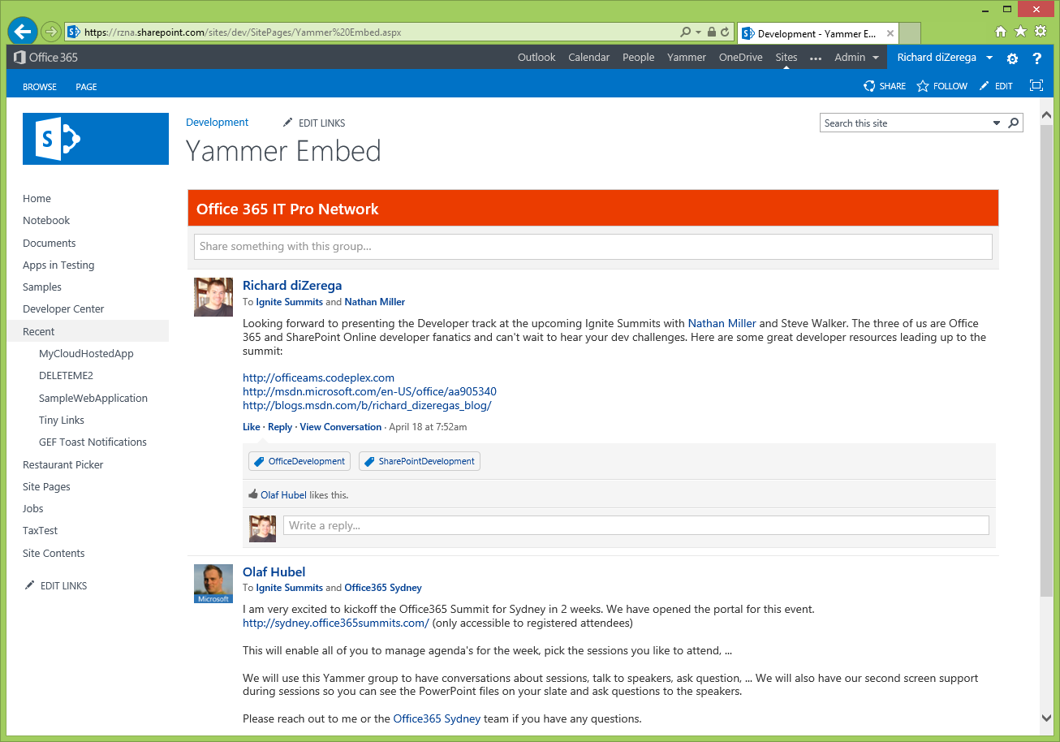
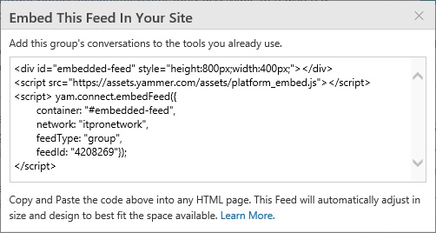
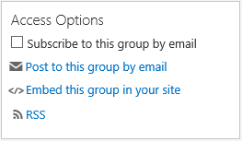
Yammer Embed
Generated from an feed in Yammer
Place a simple JavaScript widget inside any HTML based enterprise container to Embed a Yammer feed

Slide 13


REST API
Messages
Attachments
Post
Groups
Networks
Reply
Like/Unlike
Mention
Open Graph
Data Export
Tag
Search
Profiles
Invitations
Autocomplete
Follow
Unfollow
Relationships
Suggestions
Notifications

Slide 14
SDKs
JavaScript
Ruby
Python
iOS
Windows Phone 8

Slide 15
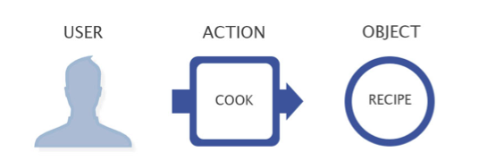
Open Graph Protocol
The Open Graph protocol models Actor (User) activities based on Actions and Objects.
Jimmy shared a file from Sharepoint.
Sam voted up an idea in Spigit.
Michelle updated a record in Salesforce.
Arisa closed a ticket in Zendesk.

Slide 16
demo
Yammer and SharePoint
Notes:
Show how to make Yammer the default social experience
Show the Yammer app part
Show Social Nucleus app

Slide 17
REST API

Slide 18
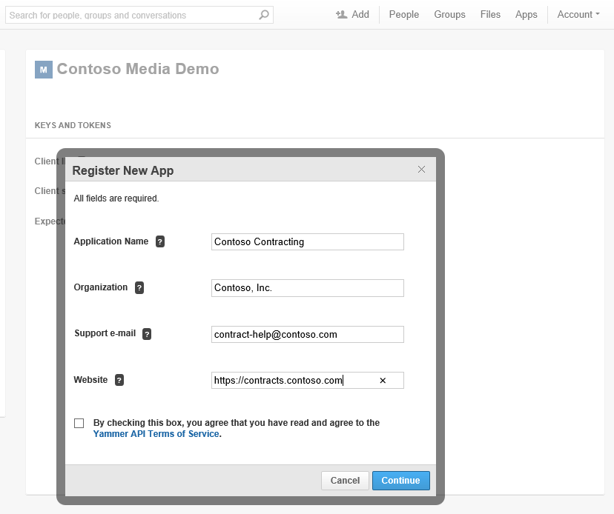
App Registration
Accessible to all users of a network
Apps are registered with a home network and then published to the directory
Redirect URI is the most important setting.

Slide 19
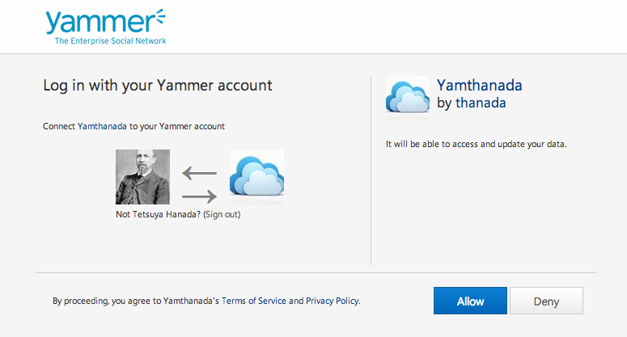
App Authorization
Redirect user to the OAuth dialog URL
Process the response at your Redirect URI when user allows the app

Slide 20
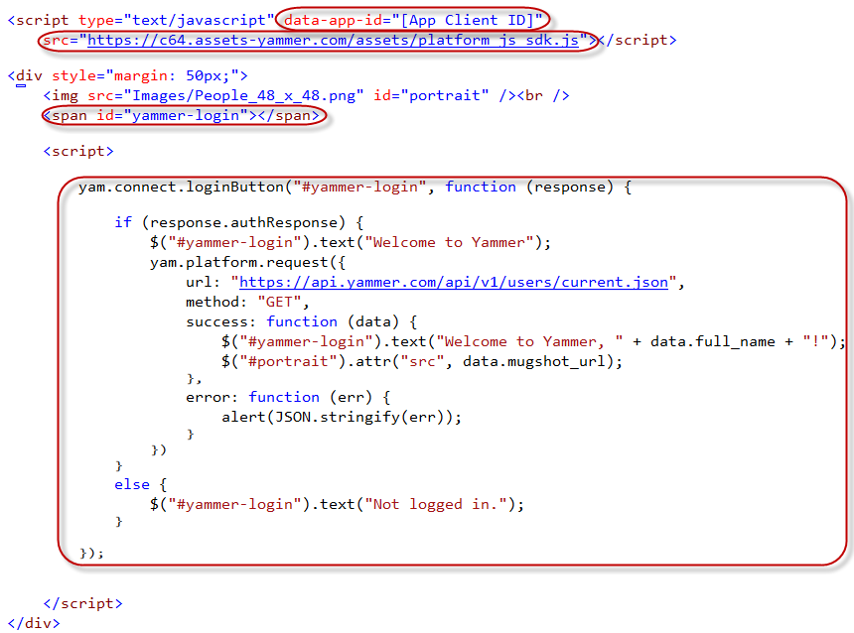
JavaScript SDK
Client ID
SDK Reference
Placeholder for “Login with Yammer” button
Create button
Complete login
Retrieve user info

Slide 21
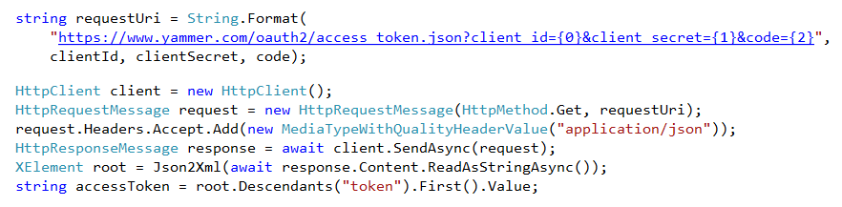
Server-Side Authorization
Redirect user to OAuth endpoint
https://www.yammer.com/dialog/oauth?client_id={0}&redirect_uri={1}
Use Authorization Code to obtain Access Token

Slide 22
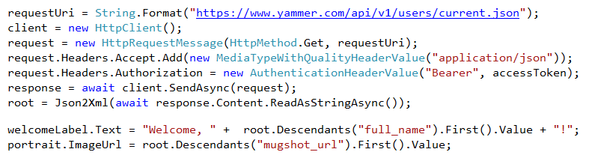
Server-Side Integration
Make calls to the REST API

Slide 23
Yammer REST APIs
Messages (https://www.yammer.com/api/v1/messages/)
Groups (https://www.yammer.com/api/v1/group_memberships)
Users (https://www.yammer.com/api/v1/users/)
Notifications (https://www.yammer.com/api/v1/streams/notifications)
Suggestions (https://www.yammer.com/api/v1/suggestions/)
Subscriptions (https://www.yammer.com/api/v1/subscriptions/)
Autocomplete (https://www.yammer.com/api/v1/autocomplete/)
Invitations (https://www.yammer.com/api/v1/invitations)
Search (https://www.yammer.com/api/v1/search)
Networks (https://www.yammer.com/api/v1/networks/)

Slide 24
Yammer REST APIs
Consider CORS when using REST client-side
Most REST APIs available via json or XML
Consider rate limits when calling REST
Autocomplete: 10 requests in 10 seconds
Messages: 10 requests in 30 seconds
Notifications: 10 requests in 30 seconds
All Other Resources: 10 requests in 10 seconds
REST requests MUST contain the access token as the “Bearer” in the “Authorization” request header

Slide 25
demo
RESt API
Notes:
Show how to make Yammer the default social experience
Show the Yammer app part
Show Social Nucleus app
Show embedding

Slide 26
OpenGraph Protocol

Slide 27



The Enterprise Graph
$
Notes:
The platform offers standard components to more easily build social networking features, such as feeds, profiles, following and likes, into business applications. This approach not only helps save developers time, it also enables enterprise customers to seamlessly connect people, conversations and data across their business applications — an experience Yammer calls the “Enterprise Graph.”
The Yammer platform solves this problem of “social network sprawl” by creating an Enterprise Graph that provides a standard set of social components. This standardization means that all of a company’s employees and business data can be brought together in a common conversation layer.
Just as Facebook is creating a social graph for people’s personal lives, mapping the connections between people, places, music and games, the Enterprise Graph shows how employees, content and business data are connected in the workplace.

Slide 28
OpenGraph for Yammer Integration
Open Graph (OG), a light weight data integration protocol, is used to define the activity which is posted to Yammer as an OG object.
It is a way to display actions or activities in a application, portal or line of business systems to a yammer feed.
Activities that show in yammer can be clicked through to the originating driving more users to important information on the system.
Examples:
In a CRM app, a sales rep updated an opportunity’s probability of closing to a lower number.
In a scheduling app, an employee created a lunch meeting.

Slide 29
OpenGraph Format
The activity takes the format:
<Actor> <Action> <Object> on <App Name>: <Message>
Actor
The actor is a Yammer user that performed an action in your app. If the actor exists in the Yammer network, the story will be delivered to the actor and others depending on the delivery rules specified.
Action
The action is a verb that describes what happened to the object e.g. created, updated, deleted, followed, liked, etc).
Object
The key piece of any activity is the Open Graph (OG) object on which action was taken. An OG object represents an entity instance in your application. OG objects are uniquely identified with their URL and their title is displayed in Yammer as a link to the URL.

Slide 30
Activities
Format
<Actor> <Action> <Object> on <App Name>: <Message>
"John Doe" created "Contract" on Contoso App: Signed a new client!
Standard Actions
created, updated, deleted, followed, liked
Custom Actions
built, deployed, brokered, compiled etc.
{
"activity":{
"actor":{
"name":"John Doe",
"email":"john@contract-meow.com"
},
"action":"create",
"object": {
"url":"https://www.microsoft.com/invoice/34242",
"title":"Sales Contract"
},
"message":"Signed a new client!",
"users":[
{"name":"Jane Doe",
"email":"jane@contract-meow.com"}
]
}
}
JSON Activity Representation
Notes:
Activities are displayed in the activity stream, and they map neatly to events in your application. Your application can make use of custom activities that you register for the object. Users are not going to be annoyed by activities because they don’t appear in message feeds.
Actor - The actor is the user that performed an action.
Action - The action is a verb that describes what happened to the object.
Standard actions are “created, updated, deleted, followed, and liked”.
Custom Actions can be created for your network.
Object – The unique URL of an object in your application.
App Name – Determined when an app is created.
Message – An optional message included with the activity stream post.

Slide 31
Supported Objects & Actions
Supported Object Types Page (default) place person department team project folder file document image audio video Company custom | Supported Action Types create update delete follow like

Slide 32
OpenGraph – Delivery
Use the end point for OpenGraph Delivery:
https://www.yammer.com/api/v1/activity.json
Activity Envelope
{"activity": {
"actor": {"name": "Jim Patterson", "email": "jpatterson@alpinestyle.com"},
"action": "create",
"object": {
"url": "https://dox.com/file/abc123.pdf"
},
"private": "false",
"message": "This is the updated version for the conference.",
"users": [
{"email": "mshamone@alpinestyle.com", "name": "Mary Shamone"},
{"email": "cammerlaan@alpinestyle.com", "name": "Christina Ammerlaan“} ]
} }
Notes:
There are also examples of Multiple Activity Stories and Single Activity Private Stories (where the URL is not publically referencable and all of the data must be passed in the openGraph.

Slide 33
demo
OpenGraph Protocol
Notes:
Show how to make Yammer the default social experience
Show the Yammer app part
Show Social Nucleus app
Show embedding

Slide 34
Embedding

Slide 35
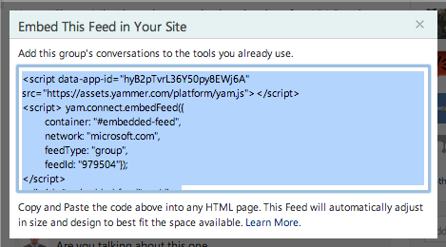
Embedding
Data out using Yammer Embed.
Place a simple JavaScript widget inside any HTML based enterprise container to Embed a Yammer feed.

Slide 36
Embed OpenGraph Feed
<script src=" https://c64.assets-yammer.com/assets/platform_embed.js"></script>
<div id="embedded-feed" style="height:400px;width:500px;">
<script type="text/javascript">// <![CDATA[
yam.connect.embedFeed({
container: "#embedded-feed",
network: "microsoft.com",
feedType: "open-graph",
objectProperties: {
url: location.href,
type: "invoice",
title: "Invoice #9382892",
image: "http://www.techready.tv/images/invoice.png"
}
});
// ]]></script>
Add Embed Snippet
“Login with Yammer”
Authorize Embed
Notes:
Adding Embed to your web application is a straightforward process:
Add yam.js reference to page.
Add appropriate initialization code to meet requirements.
Place div tag in the correct location.
In this case we’ve added one of the more advanced Embed feeds known as a Comment Feed.
Lots of things are taken care of for you, but there are a couple of common field reports:
IE Zone configuration blocks execution of the script.
3rd party JavaScript conflicts with the yam.js library.
In many cases this can be solved quickly by iFraming the HTML page hosting the Embed snippet. Correcting the IE Zone configuration, or updating the conflicting code may provide the best UX.

Slide 37
demo
Embedding
Notes:
Show embedding an open graph feed into a website

Slide 38
Summary
Overview
REST API
OpenGraph Protocol
Embedding

Slide 39
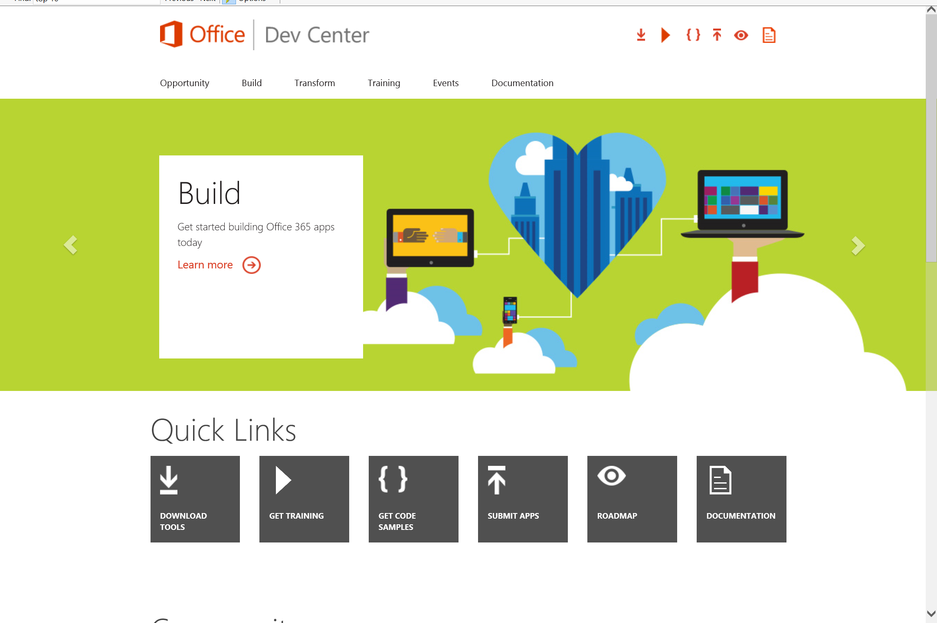
Dev.
Office
.com
One stop shop for Office Developer Platform

Slide 40
Calls to action
Explore our developer center
http://dev.office.com
Jumpstart into our training http://dev.office.com/training
Play with our code samples http://dev.office.com/code-samples
Get answers
http://aka.ms/AskSharePoint
http://aka.ms/AskOffice
Give feedback Drive our roadmap http://aka.ms/OfficeDevFeedback

Slide 41


Transform your code Providing App Model Patterns for common Full Trust Code scenarios
60+ Visual Studio projects Common scenarios
Branding
Site provisioning
Remote event receivers
Large file support
Taxonomy driven navigation
And much more…
Contribute
Open source coming soon!
Developer
Patterns & Practices
aka.ms/OfficeDevPnP

Slide 42
Microsoft Virtual Academy courses
2014
2015
Deep Dive into integrating Office 365 APIs with your mobile device development
Deep dive into the building blocks and services of the SharePoint platform
Deep Dive into integrating Office 365 APIs with your standalone web application development
Introduction to Office 365 Development
Deep Dive into the Office 365 App Model
Deep Dive into Office 365 Development on non-Microsoft Stack
Shipping your Office 365 App to the Office Store
Aug
Sept
Oct
Nov
Dec
Jan
Feb

Slide 43

© 2014 Microsoft Corporation. All rights reserved. Microsoft, Windows, and other product names are or may be registered trademarks and/or trademarks in the U.S. and/or other countries.
The information herein is for informational purposes only and represents the current view of Microsoft Corporation as of the date of this presentation. Because Microsoft must respond to changing market conditions, it should not be interpreted to be a commitment on the part of Microsoft, and Microsoft cannot guarantee the accuracy of any information provided after the date of this presentation. MICROSOFT MAKES NO WARRANTIES, EXPRESS, IMPLIED OR STATUTORY, AS TO THE INFORMATION IN THIS PRESENTATION.

